Slide 1






Lesson 24
when to

Slide 2



When to stop testing...
Is this even an issue? Isn’t the answer obvious?

Slide 3
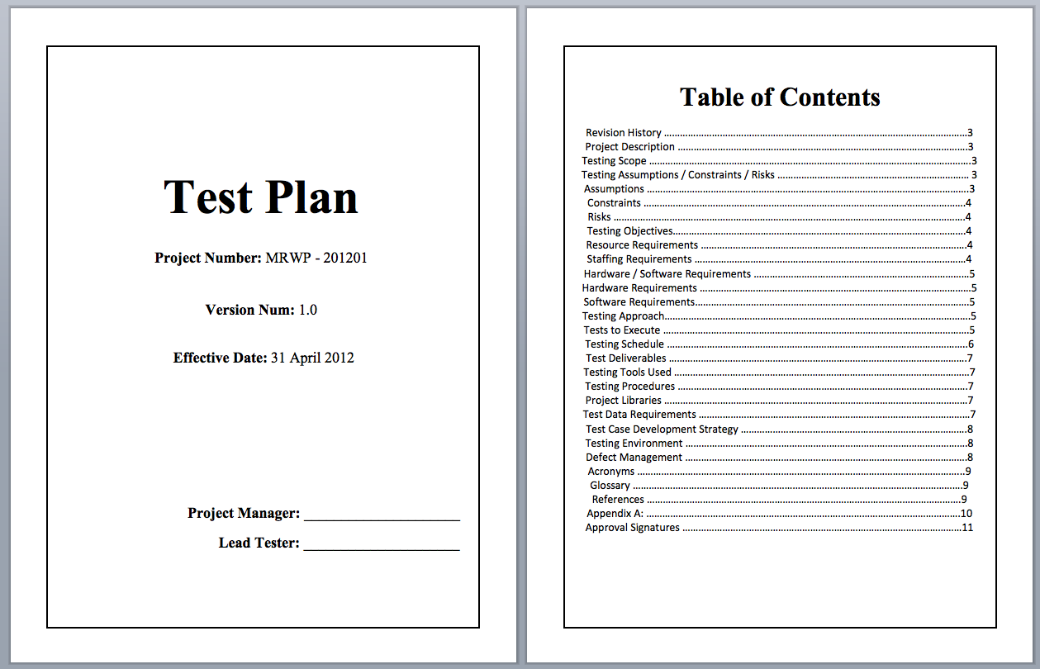
Let’s put it another way...
Jonathan Cripps

Slide 4
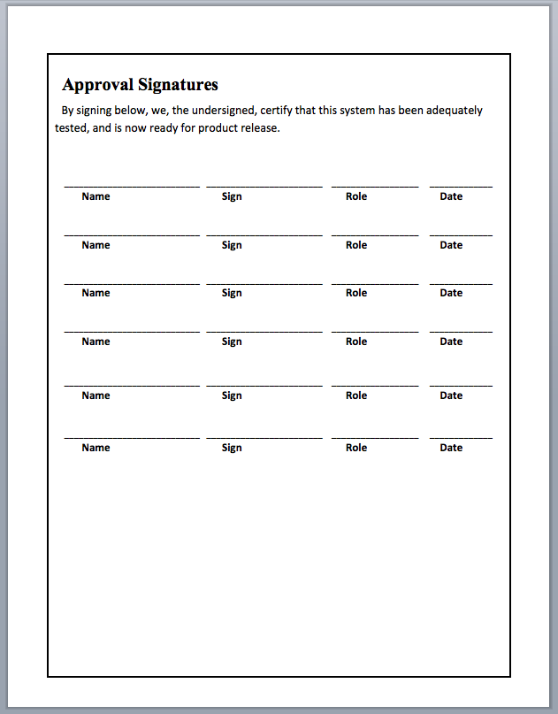
Devin Kloos Chief Programmer
Amanda Wolfe Test Planner
James Walker Chief, Autom’d Tests
Sam Bevins Software Tester
Jonathan Joyce User Representative
Colton Haller Advisor to Legal Team
Who is ready to sign?

Slide 5
On an intramural running team’s T-shirt:
THE TRUTH IS YOU COULD ALWAYS RUN HARDER
SOMETIMES THE TRUTH HURTS

Slide 6




Stopping Criteria
What would you use?

Slide 7
5 common stopping criteria:
Previously-defined coverages are met
Defect discovery rate has dropped below a threshold
Projected cost of finding remaining defects exceeds cost of letting defects into production
Project team consensus
Project management decision
What does
this mean?
What does this mean?
What does this require?
Who likes this one?
How easy is this to figure out?
What are the problems here?
What are the problems here?
Notes:
Problems with 4: What if there’s sharp disagreement?
Problems with 5: What if management is more committed to schedule than quality/reliability?

Slide 8






5 common stopping criteria:
Previously-defined coverages are met
Defect discovery rate dropped below a threshold
Projected cost of finding remaining defects exceeds cost of letting defects into production
Project team consensus
Project management decision
← How well would this criteria...
Help us meet this goal ↴
“...when you reasonably believe that the probability is low
that the product still has important, undiscovered problems”

Slide 9
So, what’s the right thing to do?
Previously-defined coverages are met
Defect discovery rate dropped below a threshold
Projected cost of finding remaining defects exceeds cost of letting defects into production
Project team consensus
Project management decision

Slide 10


What do these two things have in common?

Slide 11
So, what’s the right thing to do?
Previously-defined coverages are met
Defect discovery rate dropped below a threshold
Projected cost of finding remaining defects exceeds cost of letting defects into production
Project team consensus
Project management decision

Slide 12


When all these best practices are met:
predefined assumptions and goals
aware of important technical problems
aware of problematic parts of the software
knowledgeable about commensurate risks
certain you’re not suffering from “tunnel vision”
available resources used wisely and effectively
meeting standards clients would expect you’ve met
then, and only then, can you....

Slide 13
This slide intentionally left blank

